Slide 1

Heart Disease Diagnosis Analysis
MADE BY:
Prachi Mehta

Slide 2


Problem Statement
Health is real wealth in the pandemic time, we all realized the brute effects of COVID-19 on all irrespective of status. The task is to analyze the health and medical data for better future preparation.
Software Used
Tableau Public

Slide 3

Dataset Columns
Age
Sex (Male/Female)
CP (Chest Pain)
Trestbps (Resting Blood Pressure)
Chol (Serum Cholesterol)
Fbs (Fasting Blood Sugar) (>120mg/dL)
Restecg (Resting Electrocardiographic)
Thalach (Maximum Heart Rate)
Exang (Exercise Induced Angina)
Oldpeak (ST depression induced by exercise relative to rest)
Slope (the slope of the peak exercise ST segment)
CA (number of major vessels (0-3) colored by fluoroscopy)
Thal (Thalassemia)
Target (heart disease/ no heart disease)

Slide 4

Data Cleaning
Data cleaning is an important step that helps to prepare a dataset for analysis. The data cleaning for this project has been done using MS Excel. Some of the data-cleaning steps taken are:
Identified and removed duplicate records to ensure each patient’s data is unique.
Made sure that each column has an appropriate data type.
Created new columns to replace the numeric codes with meaningful labels to enhance the readability and analysis. For eg – restecg, cp etc.
Created new columns to categorize the data such as grouping age into age groups.

Slide 5
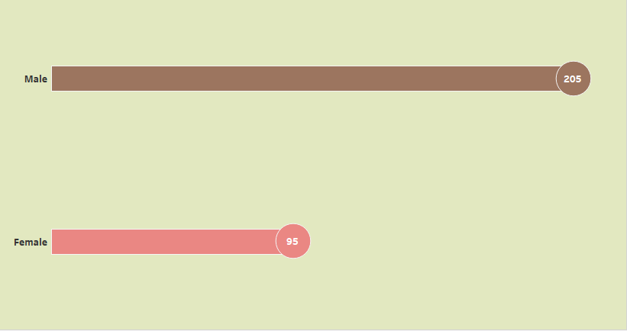
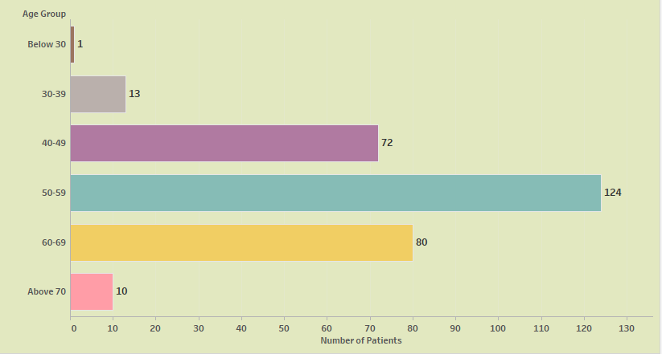
Patients Demographics
The maximum number of patients is between the age group of 50-59.
The total number of male patients is more than female.

Slide 6
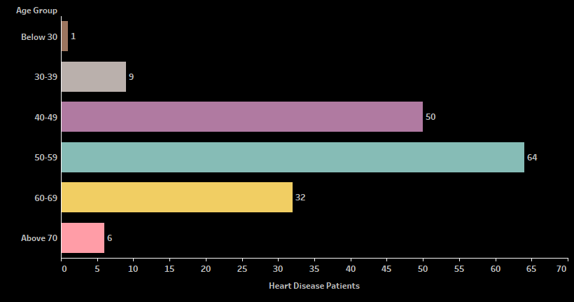
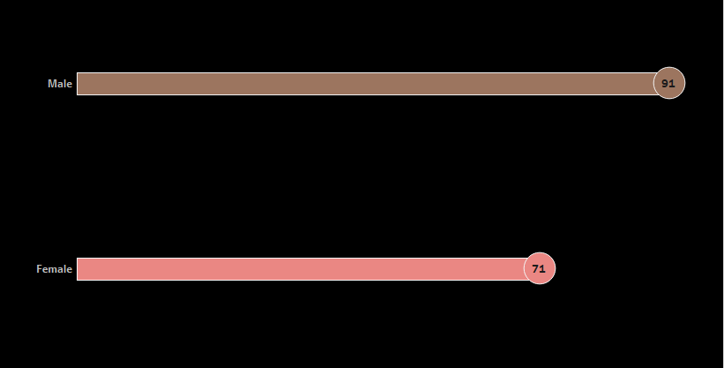
Heart Disease Distribution
64 patients are most affected by heart disease whose age group is between 50-59 and between the age group of 40-49, a total of 50 patients are affected by heart disease.
As per gender, male patients are more likely to get affected by heart disease as compared to females.

Slide 7
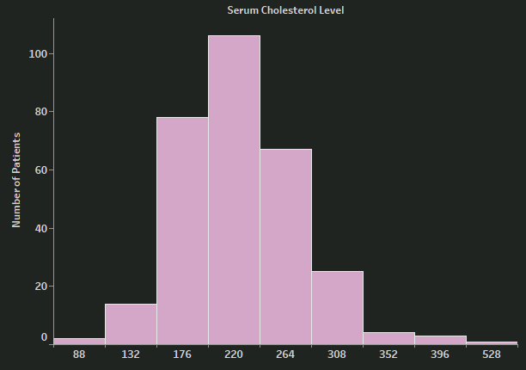
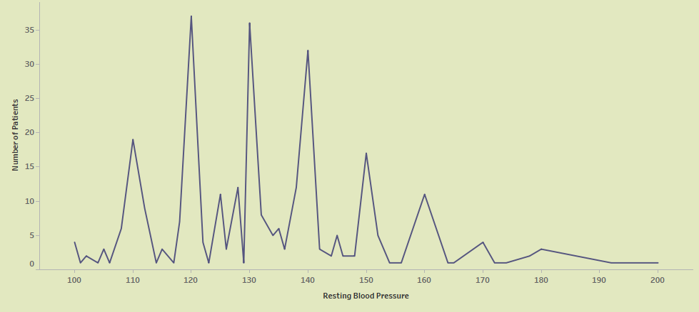
Clinical Measurements
106 patients have cholesterol levels between 220-263 which can be considered a portion of our patient population is either at borderline or having high cholesterol levels.
37 patients have a resting blood pressure of 120 which means they are in the elevated stage (prehypertension), 36 patients have a resting blood pressure of 130 which means they are at hypertension stage 1, and 32 patients have a resting blood pressure as 140 which means they are in hypertension stage 2.

Slide 8
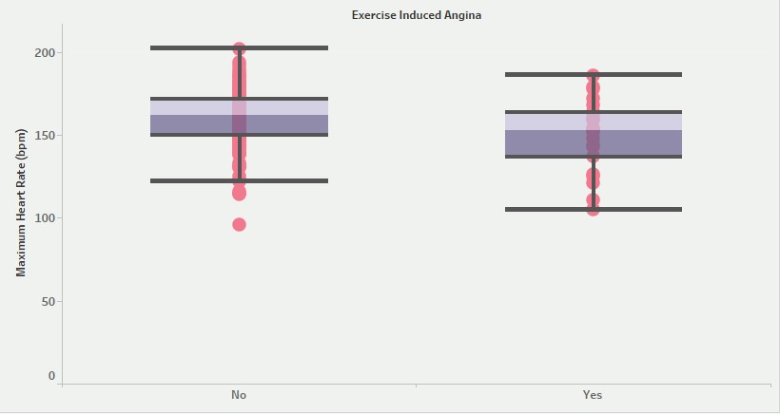
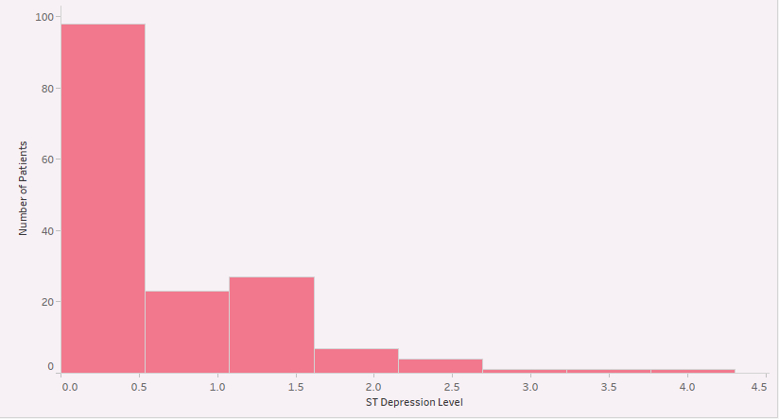
Analysis of Key Indicators
Patients without exercise-induced angina (No) have a median heart rate of 162 bpm showing a higher median heart rate with less variability. Therefore, it can be concluded that patients without angina maintain a relatively stable and higher heart rate.
Patients with exercise-induced angina (Yes) have a median heart rate of 153 bpm which shows a lower median heart rate with more variability which can indicate a diverse response because of varying severity of angina or underlying heart conditions.
98 patients have ST depression levels between 0.0-0.4 which means that patients might be in the early stages of ischemia (reduced blood flow) which may need early intervention to prevent progression to more severe forms of heart disease.

Slide 9

Key Findings
The most affected age group is between 50-59.
Males are most affected compared to females.
The patients affected have either borderline or high cholesterol levels which increases the risk of developing heart disease.
The patients affected are either at risk of developing hypertension or have already elevated blood pressure that can lead to serious health issues.
Patients with exercise-induced angina have lower and more variable heart rates which would require a need for individualized clinical attention.
The ST Depression levels indicate early ischemic changes that may not have severe symptoms but can still lead to underlying cardiovascular stress.
Majority of patients are found to have ST-T Wave abnormalities in their ECG which can lead to potential cardiac issues.
Moderate Thalassemia is found among patients which can impact their cardiovascular health.

Slide 10

Recommendations
Regular health checkups for those in high-risk groups.
Adapt to healthier lifestyle practices to manage cholesterol and blood pressure levels.
Get proper sleep
Manage stress
Quit all the bad habits that can affect health (smoking, drinking, etc.)
Maintain a healthy diet
Patients with high or borderline high cholesterol levels should be closely monitored and undergo further diagnostic testing to assess the overall cardiovascular risk.

Slide 11
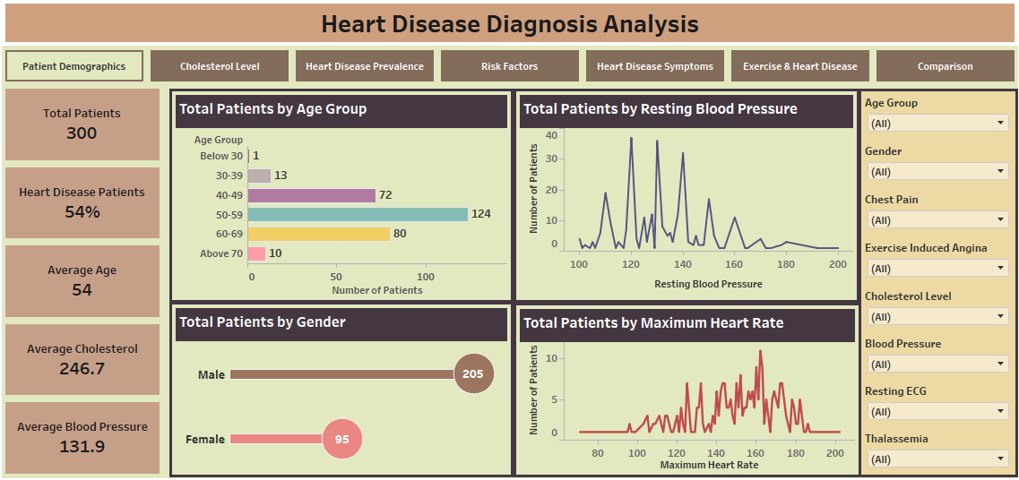
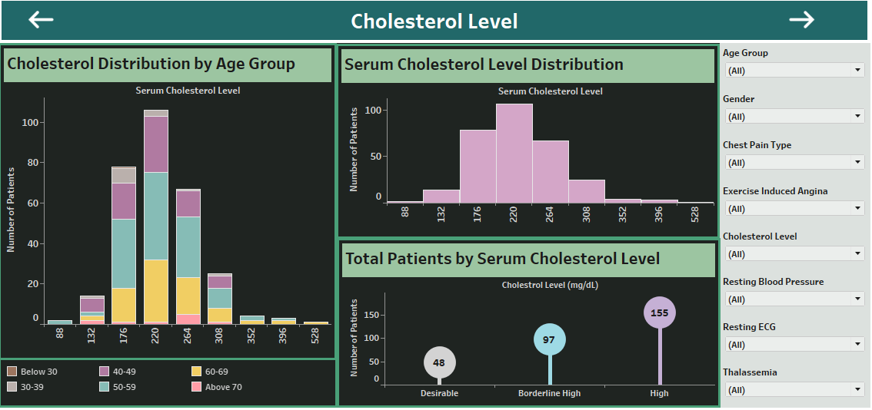
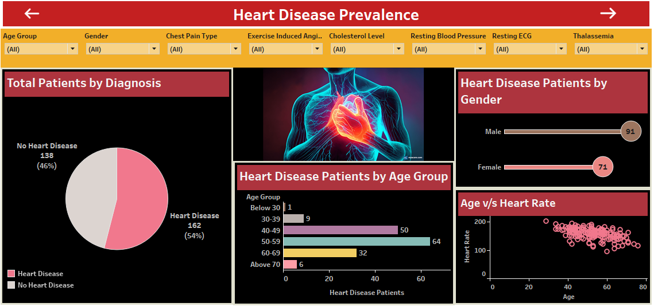
Dashboard Designs

Slide 12
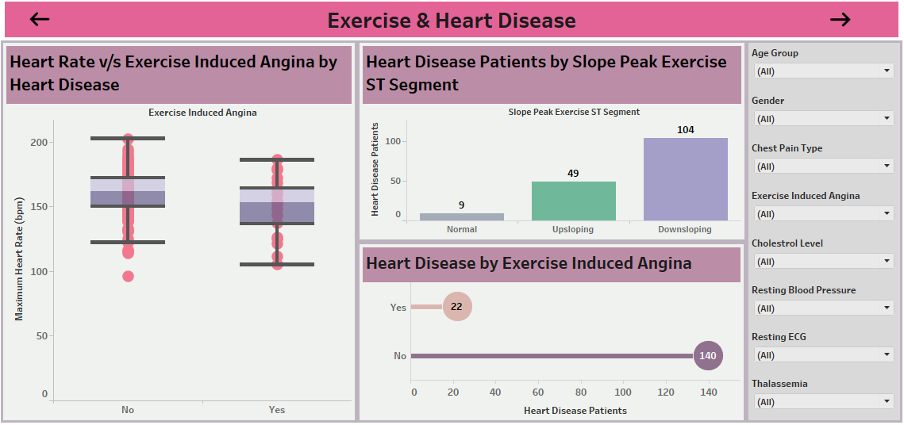
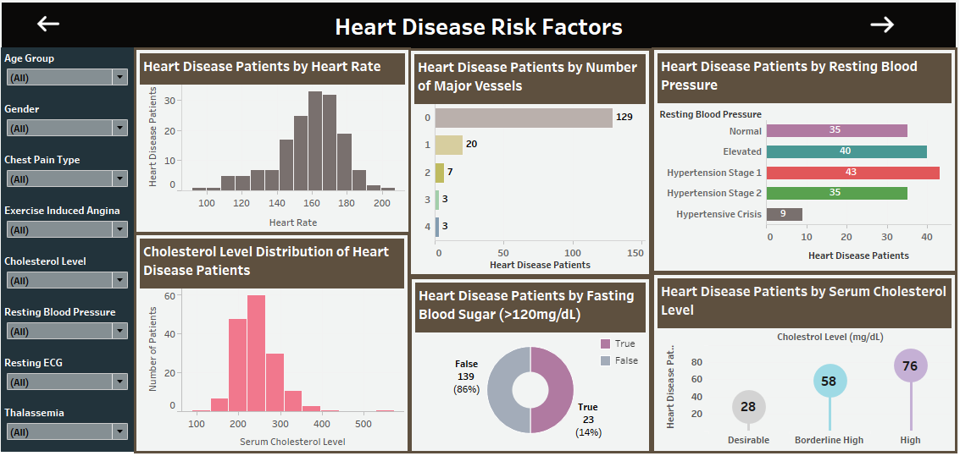
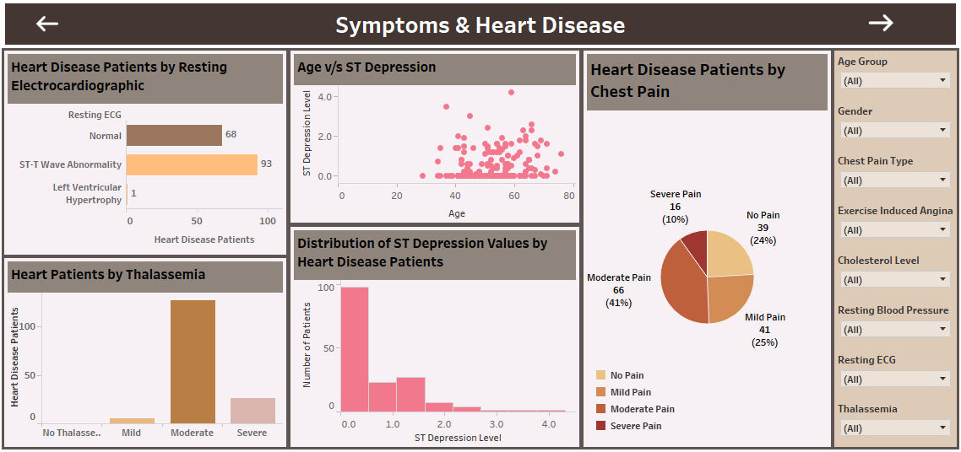
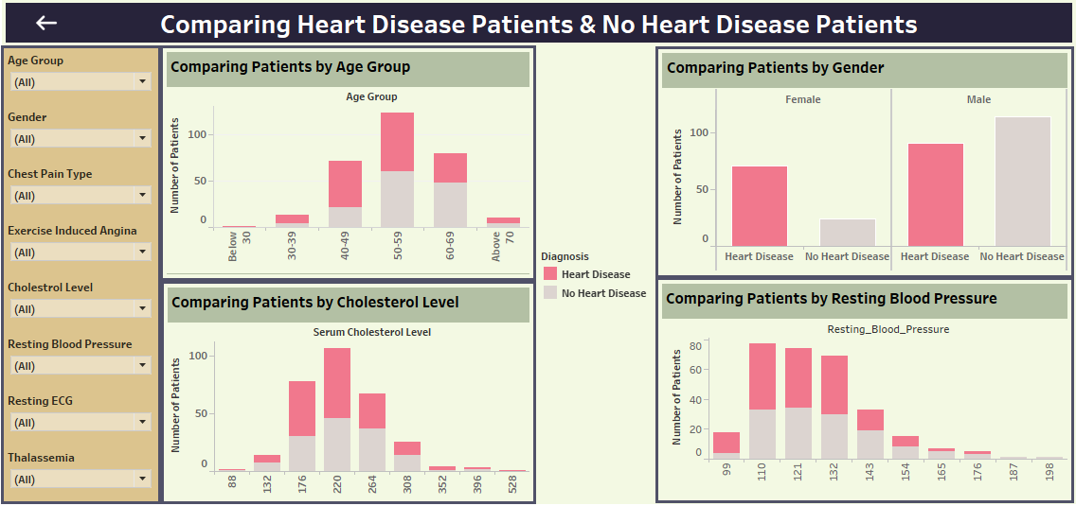

Slide 13
Thank You
Project link
https://public.tableau.com/views/HeartDiseaseDiagnosisAnalysis/Demographics?:language=en-US&:sid=&:redirect=auth&:display_count=n&:origin=viz_share_link

